Slide 1



SMART SYSTEM DEVELOPMENT FOR MULTI-MODAL PHYSIOLOGICAL SIGNAL COLLECTION AND MENTAL STRESS ASSESSMENT
Deepak Kumar
Debajyoti Roy
Austin Paul
NATIONAL
INSTITIUTE OF TECHNOLOGY
AGARTALA
3rd Year
Electronics &
Communication Engineering
NIT AGARTALA
3rd Year
Electronics
& Communication Engineering
NIT AGARTALA
3rd Year
Computational Mathematics Engineering
NIT AGARTALA
Project Mentor
Dr. Manas Rakshit
Asst. Professor
NIT AGARTALA

Slide 2

Introduction
Mental stress is known to cause a variety of physiological changes, including changes in heart rate, brain activity, and skin conductance. By analysing these signals, the study hopes to develop a dependable way for scientifically estimating and monitoring mental stress levels in real time.
Mental stress can have significant negative impacts on both physical and mental health.
Prolonged exposure to stress has been linked to a wide range of health problems, including cardiovascular diseases, weakened immune system, anxiety disorders, depression, and more.

Slide 3
Mental stress assessment: an important concern
Early Intervention
Improving Mental Health
Early detection enables timely intervention and support for individuals experiencing stress.
Detecting stress levels can lead to better mental health outcomes and reduced long-term impact.
Suicidal Rates
Personal Well-being
In 2022, global suicides surged by 27% compared to 2018, with India topping the list for the highest number of suicides worldwide.
Monitoring stress levels promotes individual well-being and prevents adverse health effects.

Slide 4
Current trends in mental stress assessment
Counselling Centres.
Harnessing Form Filll-up.
Physiological Signals.

Slide 5
Objectives:
Development of analog front-end circuit for single channel ECG signal collection.
Development of analog front-end circuit for multi-channel EEG acquisition.
System integration for simultaneous physiological signals (ECG, EEG, galvanic skin response) acquisition.
AI based algorithm development for physiological signal processing and reliable mental stress assessment.
Outcomes:
Real-time system multi-modal physiological signals (ECG, EEG, galvanic skin response) collection from human body.
AI based GUI system for philological signal processing and mental stress level assessment.

Slide 6

Multi-modal Physiological Signals
Electrocardiogram (ECG): Measures electrical activity of the heart.
Electroencephalography (EEG): Records electrical activity of the brain.
Galvanic Skin Impedance (GSR): Monitors changes in skin conductance.

Slide 7
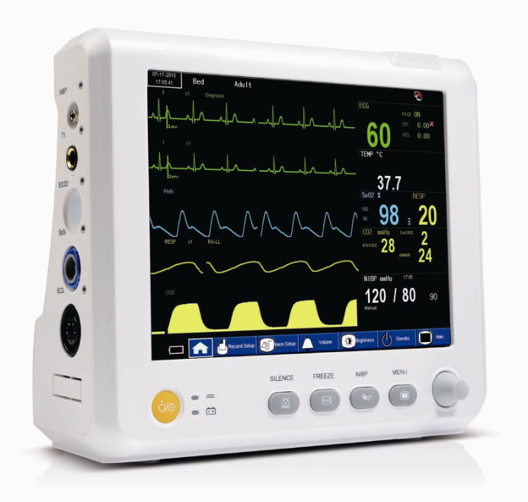
Electrocardiogram (ECG)
Electrocardiogram (ECG) is a vital physiological signal used for detecting mental stress levels.
It measures the electrical activity of the heart, providing valuable insights into heart function and stress response.
During an ECG, electrodes are placed on the skin of the chest, arms, and legs.
Hear rate changes with different mental stress condition.

Slide 8
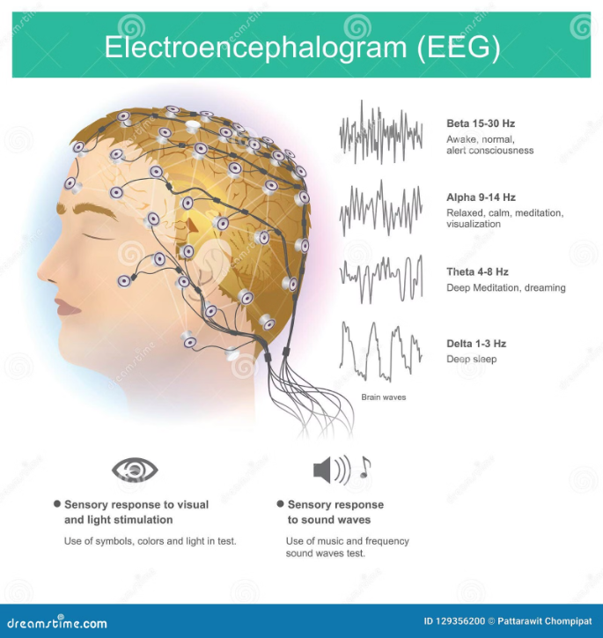
Electroencephalography (EEG)
Electroencephalography (EEG) is a non-invasive method to record electrical activity of the brain. It measures voltage fluctuations within the neurons of the brain.
It involves placing electrodes on the scalp to detect and measure the fluctuations in voltage resulting from the electrical currents within the brain's neurons.
EEG recordings can provide valuable insights into brain function and activity, such as identifying patterns associated with different states of consciousness, sleep stages, cognitive processes, and neurological disorders.

Slide 9
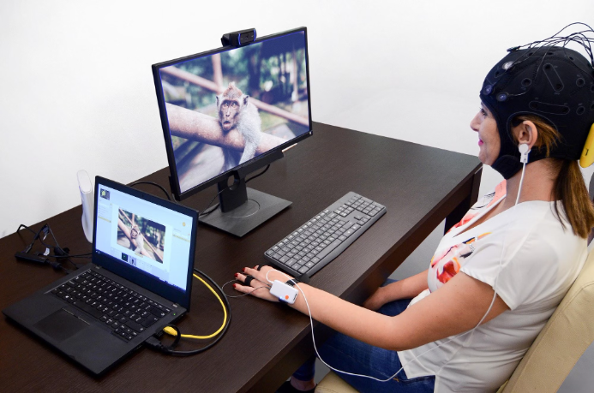
Galvanic Skin Impedance (GSR)
Galvanic Skin Impedance (GSR) measures the skin's electrical conductance. When a person experiences stress, the skin's electrical conductivity changes due to sweat production, making GSR a valuable indicator of emotional arousal.
It can provide insights into emotional processing, stress levels, attentional focus, and other aspects of human behavior and physiology.

Slide 10



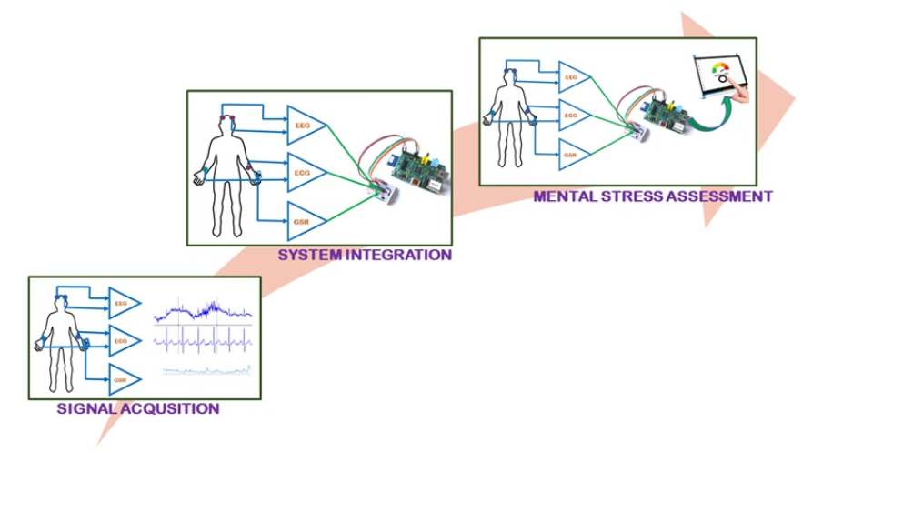
Data Collection and Processing
Signal Acquistion
System Integration
Data Analysis
Utilizing advanced technology for accurate data capture and analysis.
Once we get the signals from the end devices, it is integrated. This might imply merging the data streams into a single data format.
Data analysis is a vital phase in the process of comprehending and interpreting acquired data and determining which sort of level in mental stress assessment this is.

Slide 11
Machine learning algorithms for stress assessment
1
Data Collection
Gathering physiological signals (ECG, EEG, and GSR data).
2
Pattern Identification and Data Preprocessing
Identifying relevant features from the collected signals.
3
Model Training and Testing
Using machine learning algorithms to train and evaluate stress level classifiers.

Slide 12
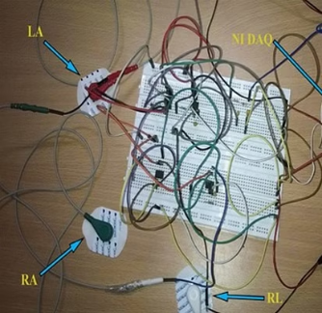
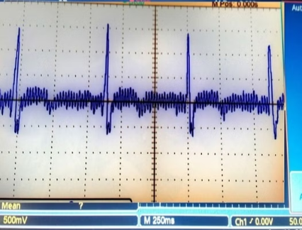
Outcome till date
Real time single channel ECG collection from human body.

Slide 13
Business Prospective and Revenue Model
Partnership Opportunities
Data Monetization
Collaborating with healthcare institutions for stress management solutions and corporate wellness programs.
Anonymous data insights and trend analysis for research and targeted advertising partnerships.
Licensing and Integration
Offering APIs and licensing the technology for integration with wearable devices and health platforms.

Slide 14
Tentative Budget
Budget Head | Year-1 Amt. (in Rs.) | Year-2 Amt. (in Rs.) | Total (in Rs.)
Consumables | 2,00,000 | 2,00,000 | 4,00,000
Contingencies | 25,000 | 25,000 | 50,000
Grand Total (in Rs.) | 2,25,000 | 2,25,000 | 4,50,000
Timeline
S. No. | Activity | Timeline (1 Bar = 3 Months)
 |  | 1 (1-3) Month | 2 (4-6) month | 3 (7-9) Month | 4 (10-12) Month | 5 (13-15) Month | 6 (16-18) Month
1. | Literature survey
2. | Development of analog front-end circuit for single channel ECG signal collection.
3. | Development of analog front-end circuit for multi-channel EEG acquisition.
4. | System integration for simultaneous physiological signals (ECG, EEG, galvanic skin response) acquisition.
5. | AI based algorithm development for physiological signal processing and reliable mental stress assessment.
6. | Publication of result, Preparation of final report for submission

Slide 15
THANK YOU

